Slide 1
Housing SQL DATA cleaning project
Ximena Bustamante

Slide 2
Introduction
This project employs Nashville housing data to be explored and clean in SQL Server Management Studio
This is a guided project led by @Alex The Analyst

Slide 3
DATASET
This dataset consists of the following 19 variables:
UniqueID
ParcelID
LandUse
PropertyAddress
SaleDate
SalePrice
LegalReference
SoldAsVacant
OwnerName
OwnerAddress
Acreage
TaxDistrict
LandValue
BuildingValue
TotalValue
YearBuilt
Bedrooms
FullBath
HalfBath

Slide 4
Data cleaning and manipulation sql

Slide 5
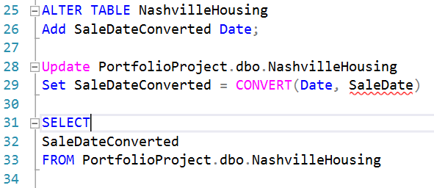
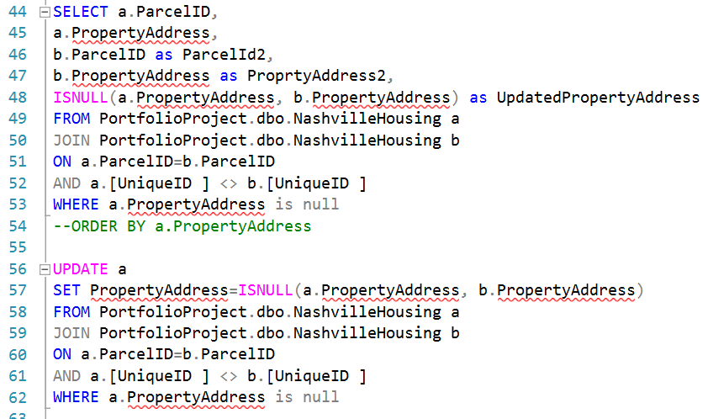
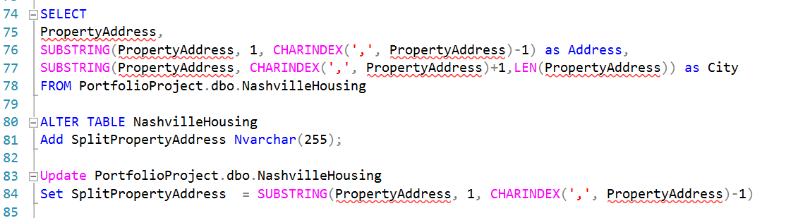
Data cleaning and manipulation sql
SQL Server Management Studio was used to clean and manipulate the data
Alter table, update and convert were used to change data type permanently
ISNULL and self joins were used to populate missing addresses
Substring and Charindex were used to break apart cities and zip codes from addresses

Slide 6
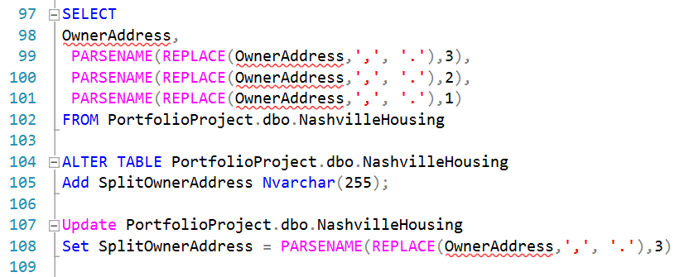
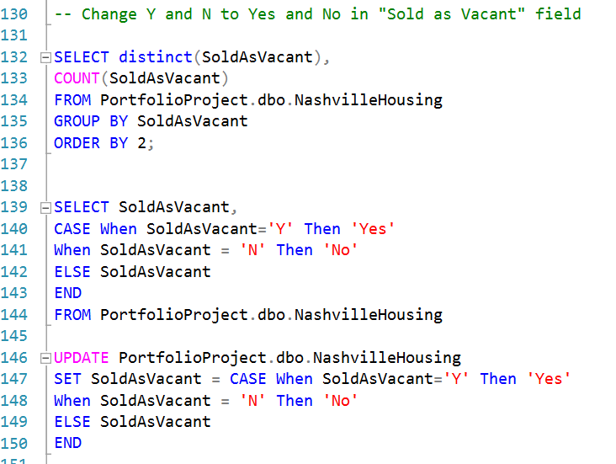
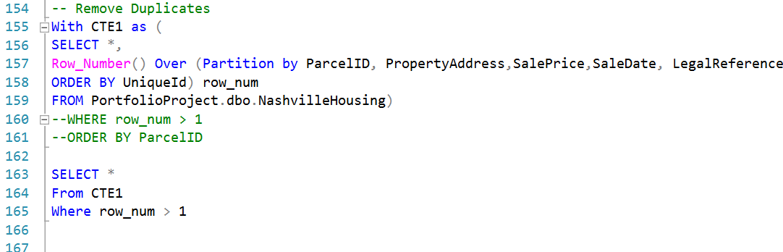
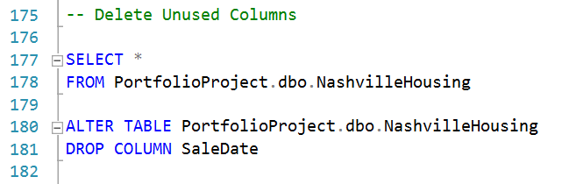
Data cleaning and manipulation sql
Parsename and replace were used to break into columns based on a delimiter
Count, case when and update were used to create a yes/no column to identify specific categories
CTEs were used to remove duplicates
Drop column and alter table were used to drop unused columns

Slide 7
Thank you for checking out my project!
Follow me for more project ideas
If you have any questions, comments, feedback, feel free to DM me!

